Slide 1
The Power of a City Brand
Defining Your City in a Moment

Slide 2
Putting a Spin on Brand
Laguna Woods
Alameda
South San Francisco
Berkeley
Lafayette
Land of Old People
Crowded with Dated Infrastructure
Industrialized Suburb of SF
Crazy Liberal College Town with Protests
Quiet Bay Area Sleepy Suburb
Retirement Turned Up to 11
Bay Area Historical Oasis
Heart of the Bay Area
Proud Progressive Community of Intellectuals
Love Lafayette – It Means What You Want

Slide 3
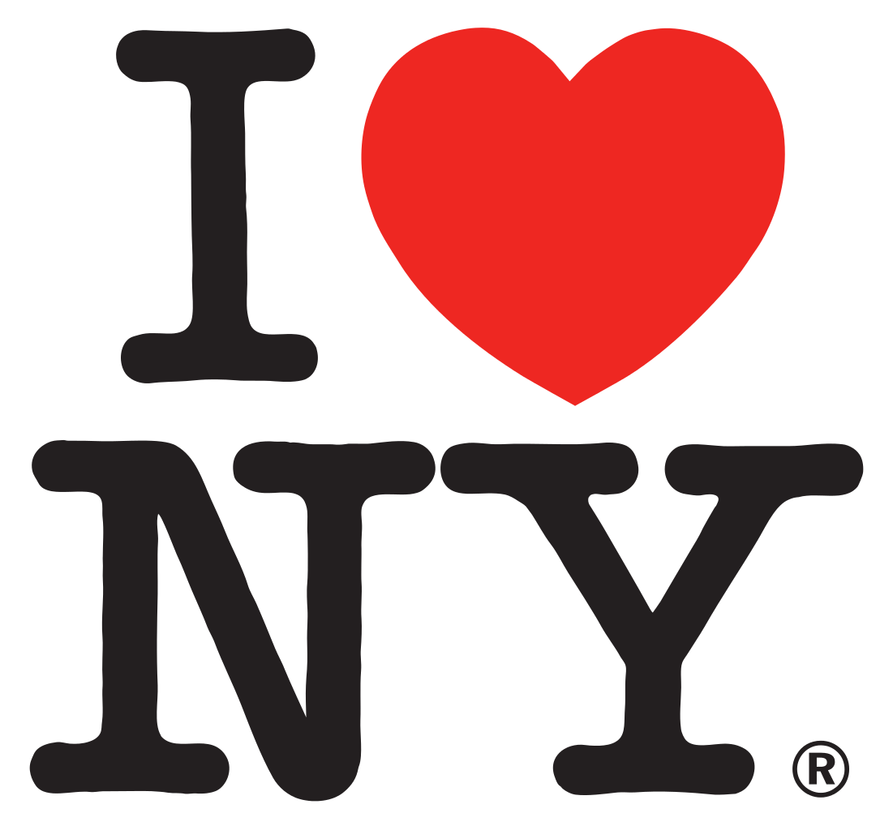
Why Brand a City?
Economic Development
Community Pride
Raise Profile
Move on from Your History
Own Your Reality
Expand Citizen Engagement and Create Sense of Belonging
Define (or Redefine) City:
-as a Place
-as an Entity
-as a Destination

Slide 4
Branding Process: Deliverables
Research Findings, Branding Concepts, Brand Position Statement
Visual Identity
Style Guide and Color Scheme
Photographic Assets and Key Landmarks
Logo
Templates and Collateral Material
Action Plan
-Strategy for Launching and Tailoring Brand to Different Stakeholders

Slide 5
Branding Process: Steps
Kickoff
-Establish Scope, Budget, Desired Outcome
Data Collection
-Interviews, Surveys, Public Meetings, Focus Groups, Market Research
Analysis
-Review Effectiveness of Current Strategy
-Key Words, Associations, and Themes
-City Strengths, and Weaknesses/Gap Analysis
Formulate and Present Concepts/Branding Options
-Present Themes and Concepts
Begin Branding Process/Crayon Phase
-Create Deliverables, Rollout Timeline
Adoption/Buy-In
-Test Final Product
-Adoption by Council
Launch the Brand/Rollout
-Publicize New Brand
-Use Materials

Slide 6
Branding Process: Stress Test Brand
For a Brand to Establish Stakeholder Buy-in and Endure it Must Be:
True
- Accurate and Current, Not Aspirational or Wishful
Distinctive
-Differentiates from Competitors and Other Cities
Compelling
-Add Value for Decision Makers and Stakeholders
Flexible
-Can Mean Multiple Things to Multiple People, Used in Multiple Contexts
Durable
-Stand the Test of Time, Have Room to Evolve, Cannot Easily be Copied by Others
*Harvard Business School Community Partners

Slide 7
Branding Process: Involving Stakeholders
Stakeholders- People, Groups, Organizations with Vested Interest in Process
Defining Stakeholders and Audience
-City Council
-City Staff
-Community, Residents, Members of the Public
-Businesses
-People Living Outside the City
Individuals
Visitors and Potential Visitors
Meaningful Stakeholder Engagement Matters at Every Phase of the Process

Slide 8
Cost of Branding
Branding Efforts Can Range From $10,000 to over $200,000
Large Portion of the Costs of Branding Spent in Data Collection and Analysis Phase
City | Consultancy | Timeline | Cost
Dublin | North Star | 36 Weeks | $128,000
Hayward | Brainchild Creative | 16 Weeks | $75,000
Santa Clara | Red Peak Group | 26 Weeks | $185,000
Glendale | North Star | 25 Weeks | $139,000
Rocklin | Bamboo Creative | 17 Weeks | $70,000
Gilroy | Articulate Solutions | 16 Weeks | $70,000
Placentia | Allegra | 10 Weeks | $25,000

Slide 9
Other Considerations
Defining Your Community Can Be Very Political, Stakeholders Have Opinions at all Phases of the Process
Too Safe
Underwhelming, Indistinguishable, Unmemorable, “I could do that”
Too Ambitious
Agency’s Vision Versus Community and Stakeholder Vision, Lack Credibility in Community, too out there for the Community
Identity Confusion
-What do we Want to be to Whom?
-Stuck in the Past
Brand May Conflict with Other Branding/Marketing Efforts
-Visitors Bureau, Existing Businesses, Chamber of Commerce
Aspiration Versus Reality
-Own Your Situation
Political Considerations, Tensions, and Paradoxes
-Your Council Members will be more Interested in this Process than the Sewer Upgrade Project
-Can’t be Everything to Everybody
Measuring Success

Slide 10
Homework
See Gilroy Branding
Google: “hello calgary this american life”
For the lazy:
http://bit.ly/1iH04wq
Brand Test: What is your City’s motto/slogan?

