Slide 1
The Environment

Slide 2
The business environment
The critical infrastructure business environment has changed
Information Technology offers opportunity for enhanced, efficient and more profitable service delivery – and competitive advantage
Threats are present, real and formidable
Impact of unmitigated threat is damage to business
Demands of governance, liability potential for cyber threat are real and unambiguous
Business must think differently about threat environment
Not a problem for which there is a solution, but a new way of thinking about threat, risk -- cyber security is now a constant element of decision making
Security is more than defense: it is an essential element of the successful company’s plan to stay in business in a threat environment

Slide 3
IT- SCADA Comparison
CHARACTERISTIC | IT | SCADA
Safety | Low Concern | Highest Concern
Network Delay | Usually acceptable | Never acceptable
Throughput (Bandwidth) | Usually high | Low
Physical Security | Easily implemented most places | Hard to implement at remote sites
Tech Refresh | Every 3 to 5 years | 15 - 20 years or more
Patching | Routine or on demand | Seldom or unfeasible
Environment | Clean, temperature controlled | Dirty, extreme temperatures
Downtime | Acceptable based on mission | Unacceptable
Environmental Impact of Incident | None | None to Catastrophic
System Security | High Concern | Low Concern
Notes:
As you can see SCADA system characteristics are FAR different from IT systems.
Safety is the #1 concern of SCADA systems, followed by Availability, then Integrity, and lastly confidentiality. Safety is the lowest concern of an IT system.
Network delay (reasonable) is usually acceptable on IT networks. Video and Voice usually can’t tolerate delay. SCADA systems can NEVER tolerate delay.

Slide 4
IT-SCADA Security Priority Comparison
IT SCADA
MOST IMPORTANT
Safety
Availability
Integrity
Confidentiality
Confidentiality
Integrity
Availability
Least Important
Notes:
1. Confidentiality limits access to only those with a need to know. Integrity prevents changing data. Availability ensures it’s there when you need it.
2. ICS/SCADA systems value safety just about as important as Availability.
3. Confidentiality of SCADA system data is irrelevant. The fact that a valve opens at 100 psi is not classified. Details about an entire process are important, but that information is typically not available on 1 component, but is available on the Data Historian. That’s one reason to spend more to protect it.
4. Remember SCADA systems are used and maintained by Operational Technology (OT) personnel

Slide 5
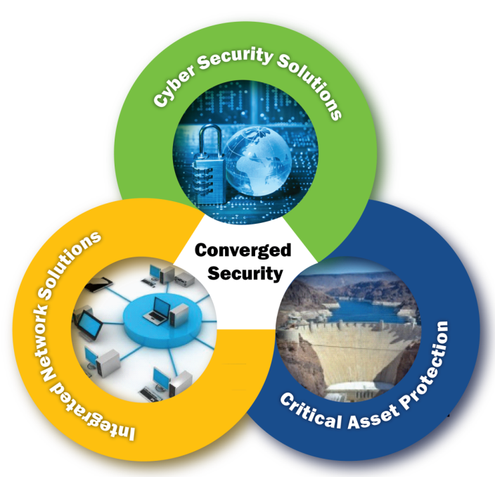
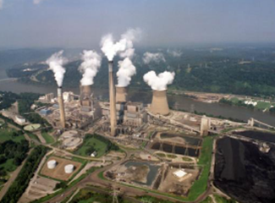
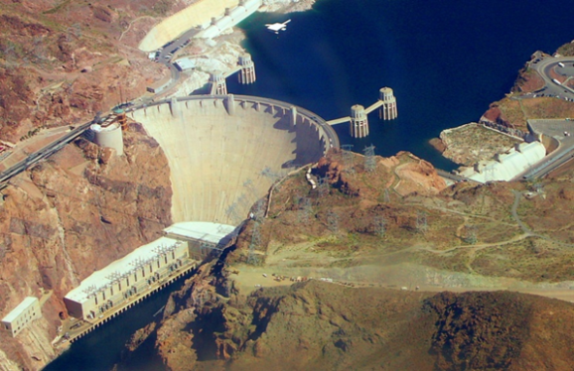
Perspective on Critical Infrastructure Protection
Cyber Security
Security of IT system
Security of OT system
Security of Physical Assets

