Slide 1
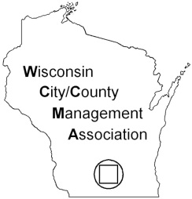
Cal-ICMA Coaching Program Boosting Talent in the Profession May 2015

Slide 2
Coaching Program: 12th year
Preparing the Next Generation Committee
Platinum Sponsors: ICMA
California Communities Joint Powers Authority
Gold Sponsors: California City Management Foundation and Chevron
Silver Sponsors: Alliant Insurance Services, County Administrative Officers Association of California, Granicus, Municipal Management Association of Northern California, Municipal Management Association of Southern California, Public Agency Retirement Services (PARS), Renne Sloan Holtzman Sakai Public Law Group, and Townsend Public Affairs
Bronze Sponsors: California Special Districts Association, County Personnel Administrators Association (CPAAC), Davenport Institute for Public Engagement at Pepperdine, International Hispanic Network, Liebert Cassidy Whitmore, Stifel Nicolaus, and Women Leading Government

Slide 3
Suite of resources serving the profession
Webinars to share best practices
Career Compass columns on key issues
Coaches Gallery of volunteer coaches
Templates to boost your local programs
and more

Slide 4
Find helpful resources online www.cal-icma.org/coaching
Agenda packets and recordings of past webinars
Registration links
for all 2015 webinars

Slide 5
Webinars on key topics
Live and digital recordings available 24/7
Over 5000 attendees in 2014

Slide 6
“Career Compass” columns
Helping people navigate their careers

Slide 7
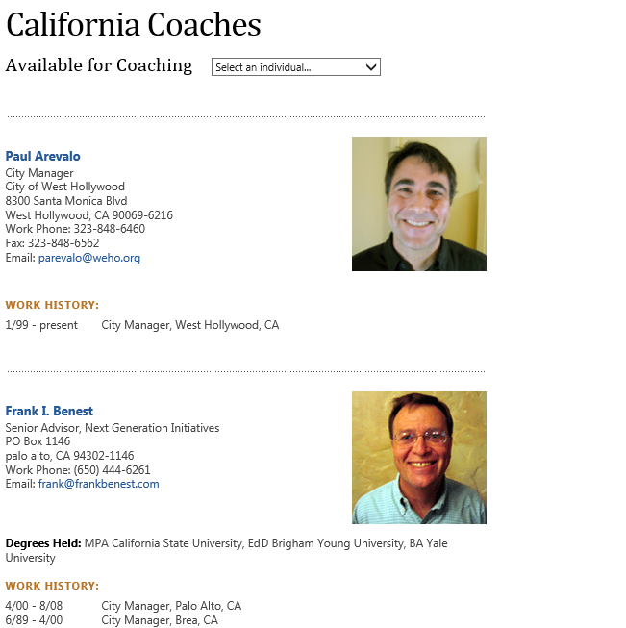
Over 90 volunteer professionals throughout California

Slide 8
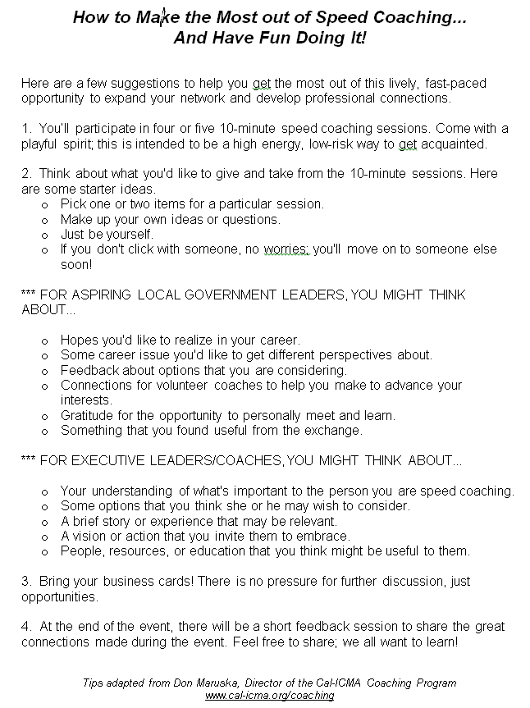
Templates to boost local programs
Proven programs you can put into practice

Slide 9
Register for upcoming webinars
“Engaging Employees Effectively”
1-2:30 p.m. PT, Wednesday, September 16
Click here to register for this particular webinar:
https://attendee.gotowebinar.com/register/3998816402061534722
Registration links for all webinars are at
www.cal-icma.org/coaching

