Slide 1

Cyber Security in Local Government

Slide 2


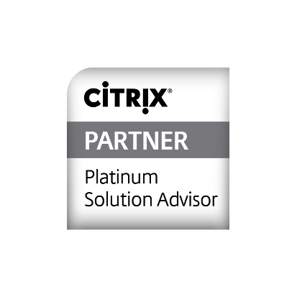
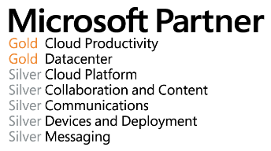
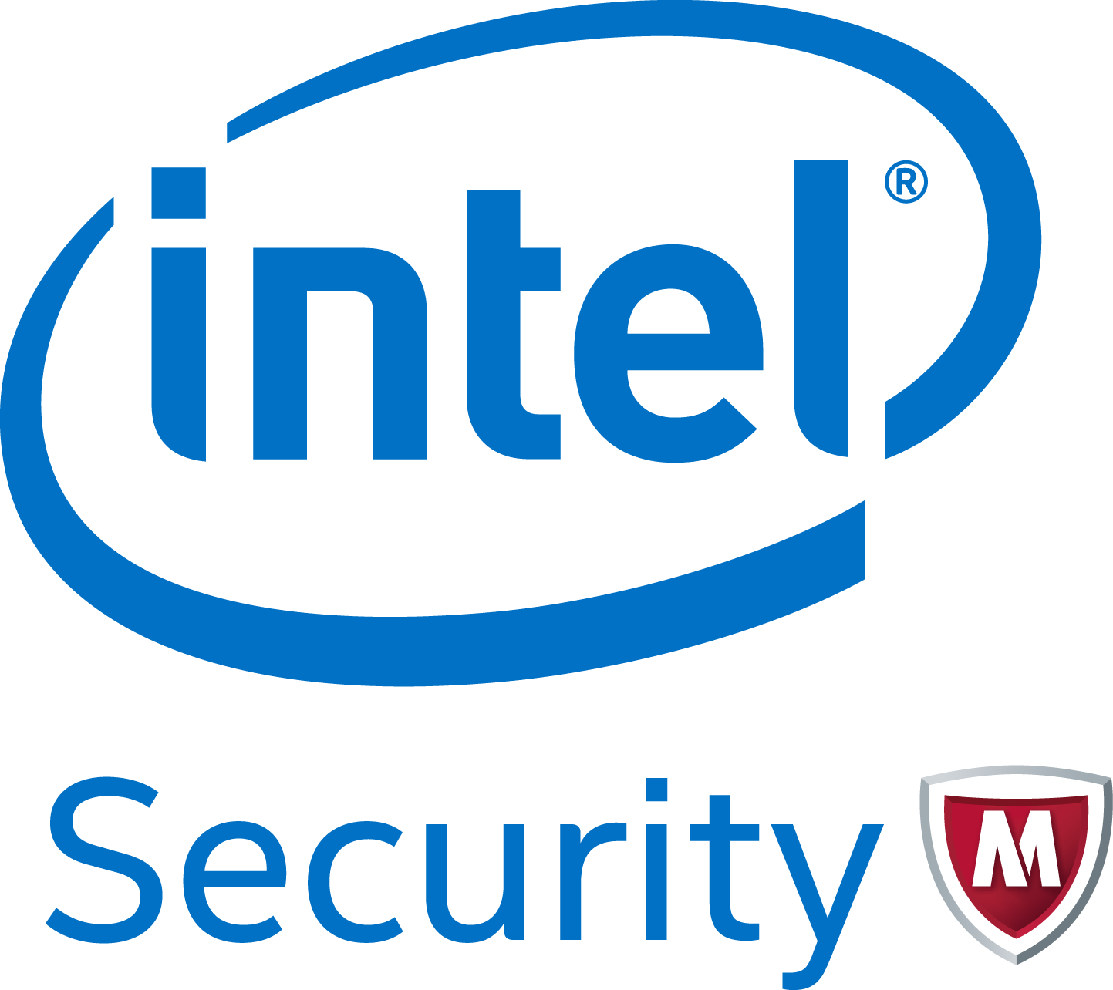

One of the Industry’s Most Widely Recognized and Highly Accredited Partners
Cisco Systems Gold DVAR
Partner/National Partner
VMware
Microsoft Gold
Managed NSP Partner
Citrix Platinum
EMC Velocity Partner
McAfee Elite

Slide 3

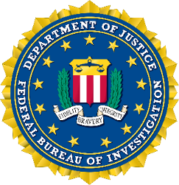



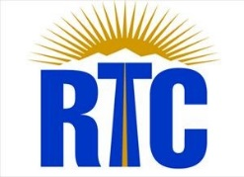











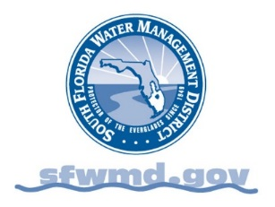






Representative Clients
FEDERAL, STATE & LOCAL GOVERNMENT

Slide 4
Some Interesting Facts
More than 94 million citizens’ records, under the care of government agencies, are estimated to have been lost or breached since 2009.¹
The average cost to the government of a single data breach has been estimated at $5.5 million or $194 per individual record.²
Government organizations with a broad range of functions—revenue, benefits, healthcare, and security to name a few—have relied on Social Security numbers (SSNs) as a unique identifier in their systems for years.
1 Rapid 7 LLC, Data Breaches in the Government Sector (September 2012).
2 Ponemom Institute LLC, 2011 Cost of Data Breach Study: Global (March 2012).

Slide 5
Some Interesting Facts
In 2012, one state experienced two data breaches, each of which exposed personally identifiable information in a different way. The first occurred from inside the organization when an employee transferred the information of more than 225,000 Medicaid beneficiaries to a personal email account.
The second breach was far more sophisticated and caused by an external cyberattack. This breach exposed information on 3.8 million taxpayers, including SSNs and bank account data, and resulted in a staggering $14 million cost to the state, the resignation of at least one high-ranking government official, and immeasurable damage to the public trust.

Slide 6
How Does This Really Happen?
It’s surprisingly simple …
About a month later, the hacker logs in with a valid userid and password, and copies a backup of one of the HR Databases.
The Attacker sends an email with a link to all Department of Revenue Employees.
Some of those people click on the link and are asked to re-enter their password.

Slide 7

Resistance is futile … You must comply
Interestingly, the state referred to on the
previous slide is compliant with IRS rules
for collecting and storing SSNs and bank
account data.
But the IRS does not require that SSN and bank account data be encrypted or masked. As a result, organizations need to consider tools that go beyond covering compliance.

Slide 8

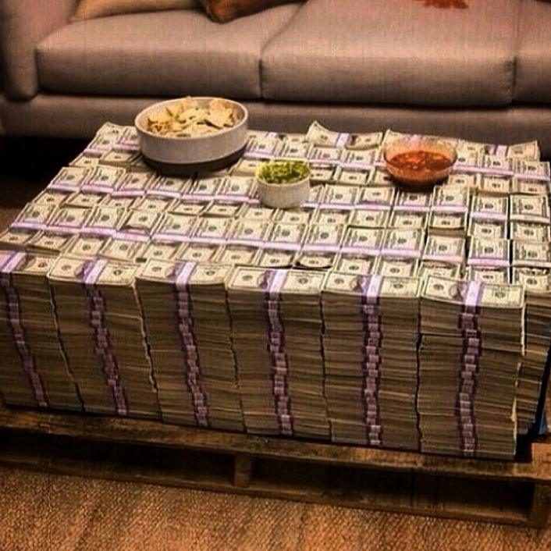
Are you doing the basics ?
Putting up walls to keep hackers
out is great, but why not keep
the really expensive items in
the safe ?
Or, would you leave your money
sitting around for everyone who
stops by to help themselves to?

Slide 9

What can you do ?
Do a compromise assessment. They are simple and often are
done by security firms at little to no cost. Companies such as
Intel Security and FireEye offer these to prospective customers.
Think about a Security Program Assessment. This not only
Identifies you where you currently are, but also creates a
roadmap toward the goal of comprehensive security.
You can’t outsource responsibility. Always hold someone
internally accountable, who holds external resources accountable.

Slide 10

Thank You & Questions

